Slide 1
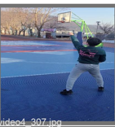
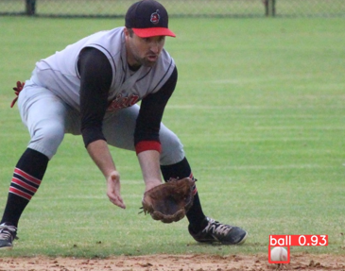
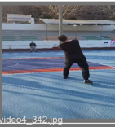
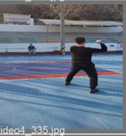
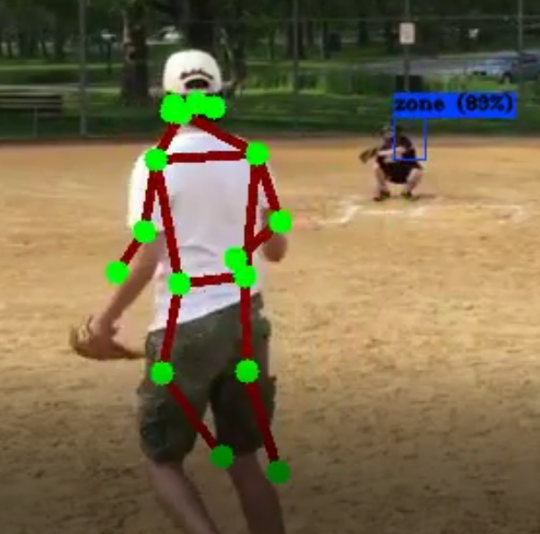
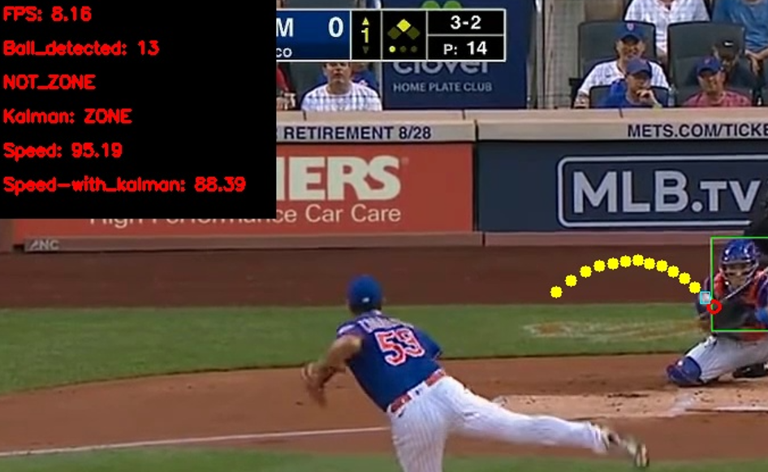
Focus
Conv
Backbone CSP
Conv
SPP
Backbone CSP
UpSample
Concat
Backbone CSP
(a)
(b)
H/h=4
K=num of key points
Center
[ B, H,W,1
1 × 1
3 × 3
Center
[ B, H,W,1
1 × 1
3 × 3
Center
[ B, H,W,1
Image
[B, H, W,3]
1 × 1
3 × 3
Center
[ B, H,W,1
s8
s16
s32
1 × 1
3 × 3
s4
(c)
Previous position + Error
Prediction
Measurement
Predicted position + Error
Update
New position
(d)
(e)

Slide 2

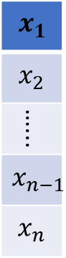
Raw Data
Raw Sensor data
(a)
(b)
(c)
$x_{1}$
$$x_{2}$$
…...
$$x_{n−1}$$
$$x_{n}$$
Dropout
1D Convolutional
1D Convolutional
1D Convolutional
1D Convolutional
1D Convolutional
1D Convolutional
(f)
(e)
A= Data
B=preprocessing
C=Feature selection
D=Class weight
E=CNN
F=output
(d)

Slide 3
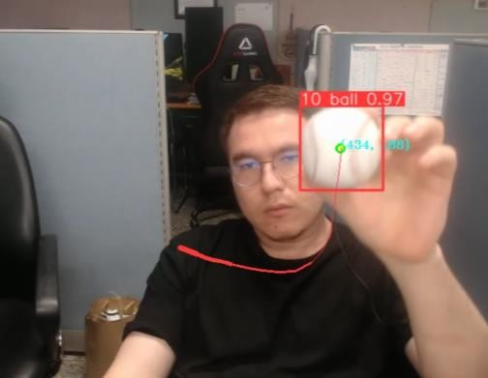
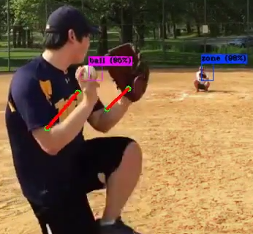
(a)
(b)
(c)
(d)

Slide 4
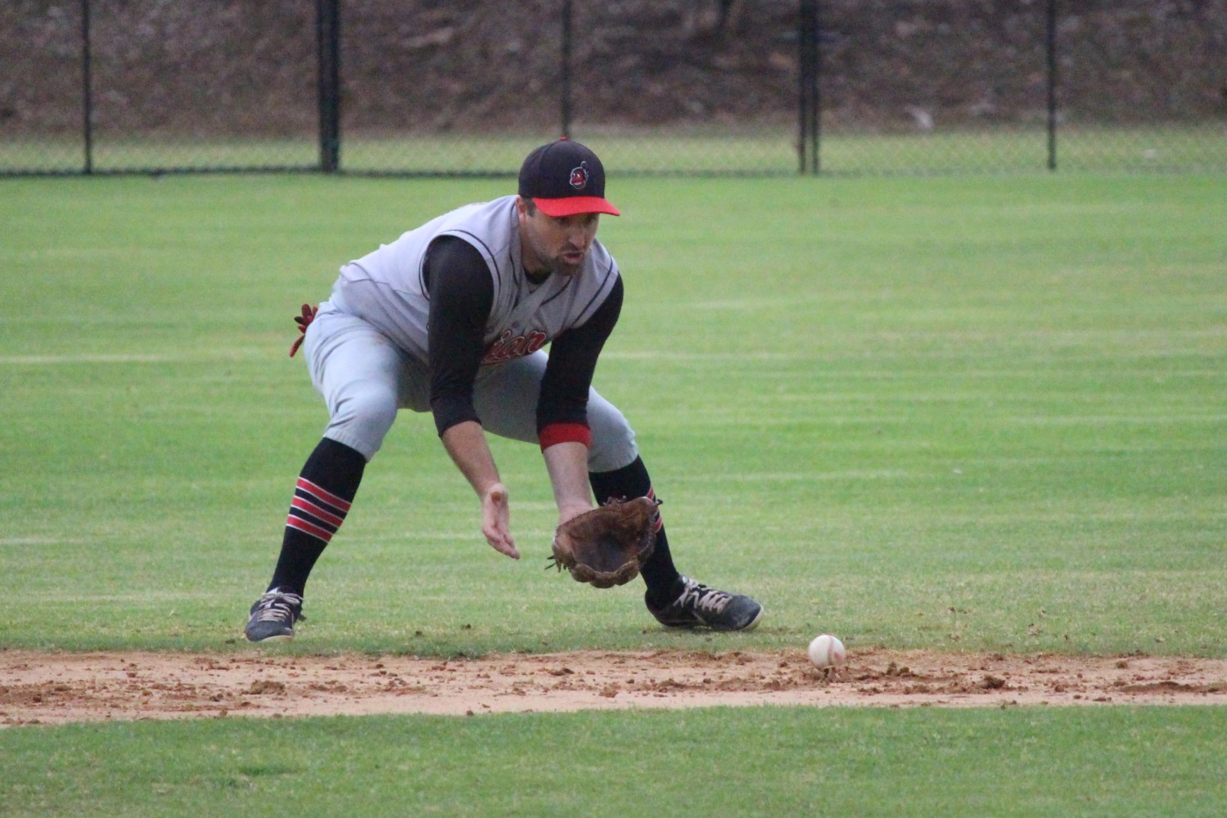
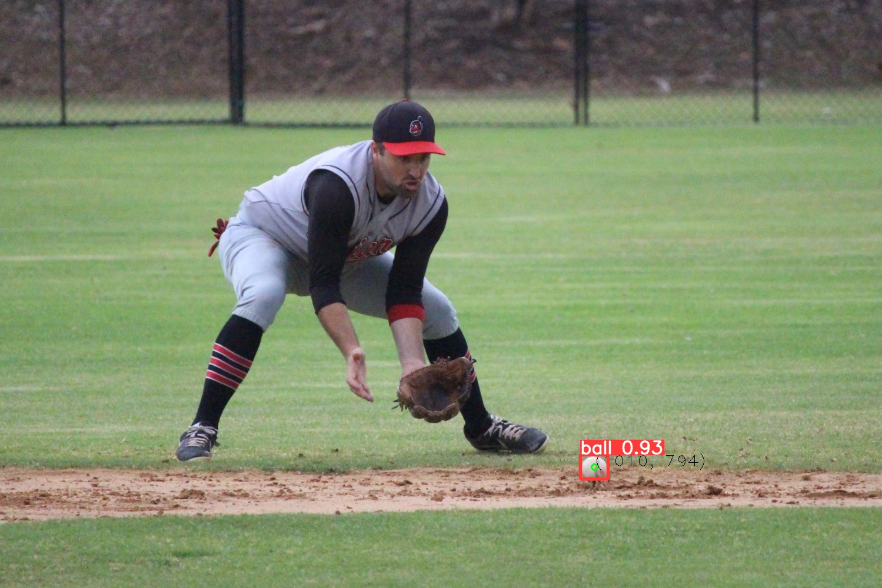
(a)
(b)

Slide 5
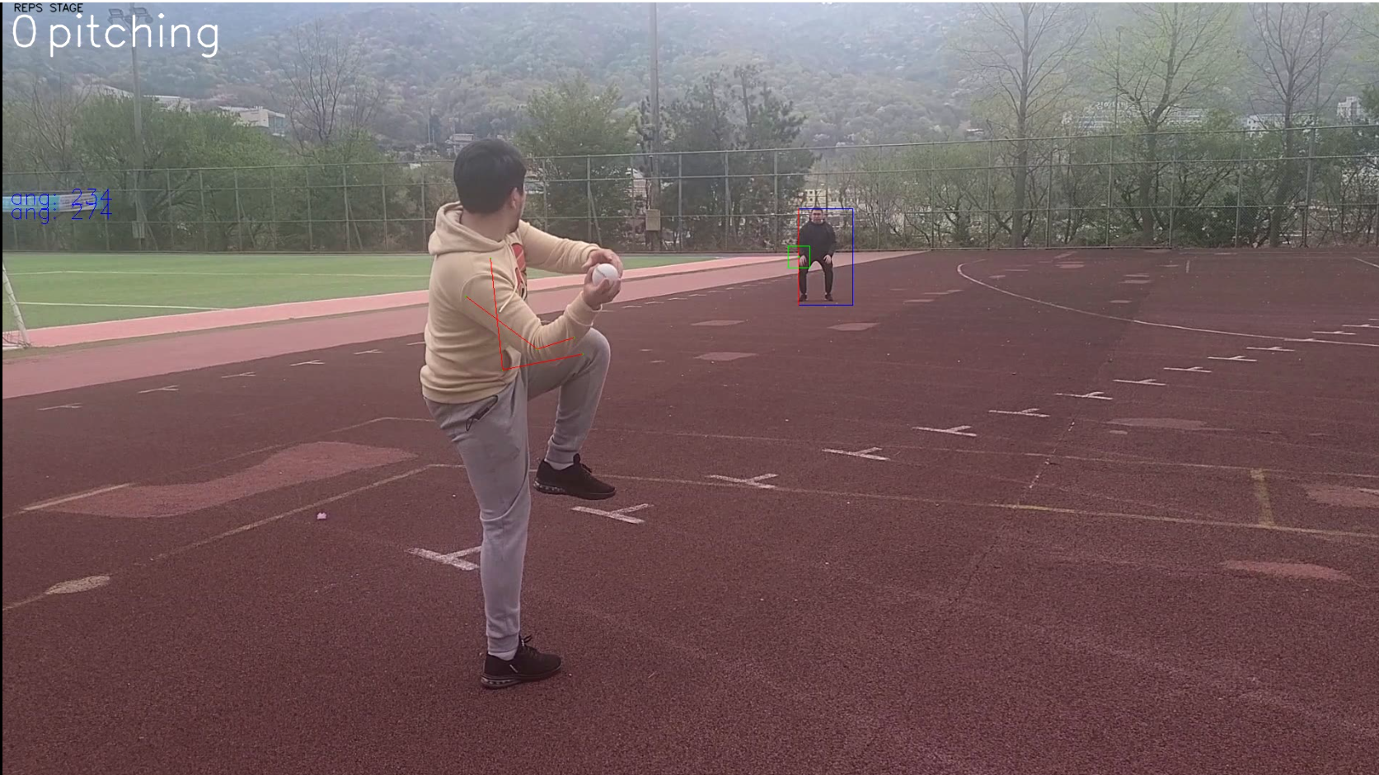
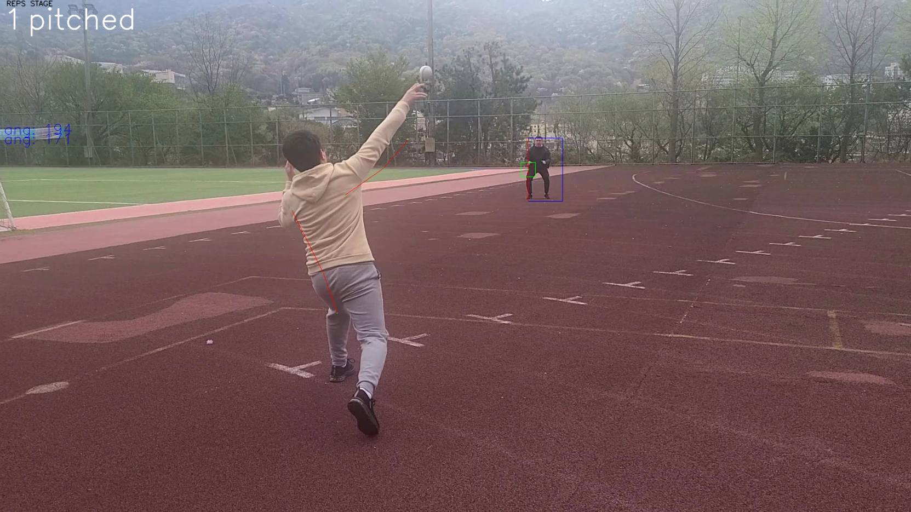

Slide 6
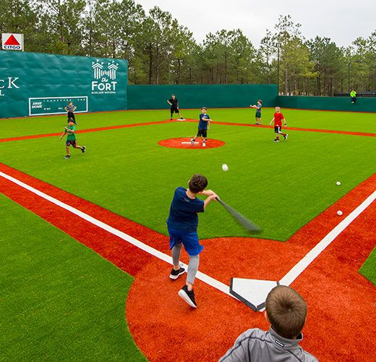
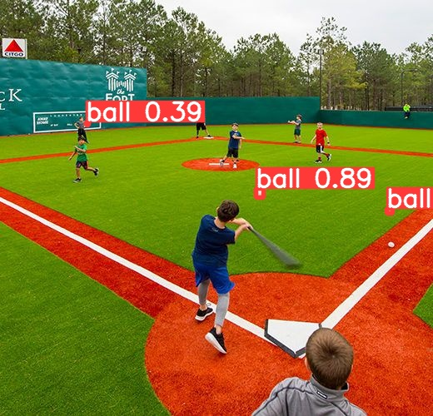

Slide 7
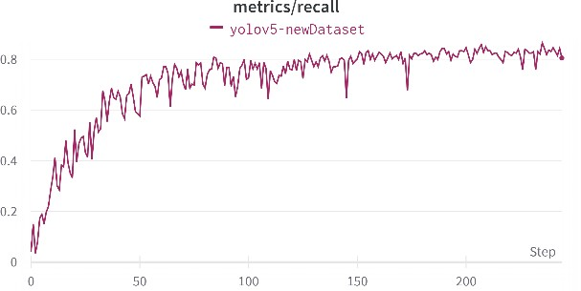
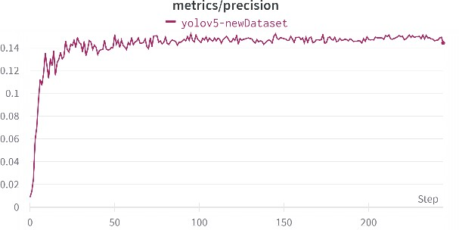
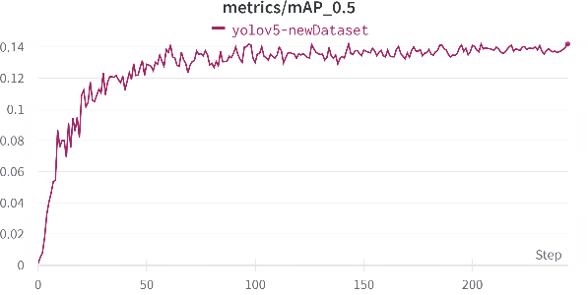
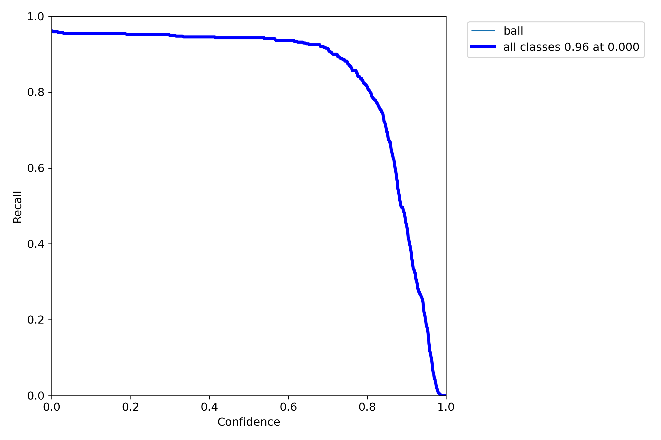
(a)
(b)
(c)
(d)

Slide 8
